Slide 1

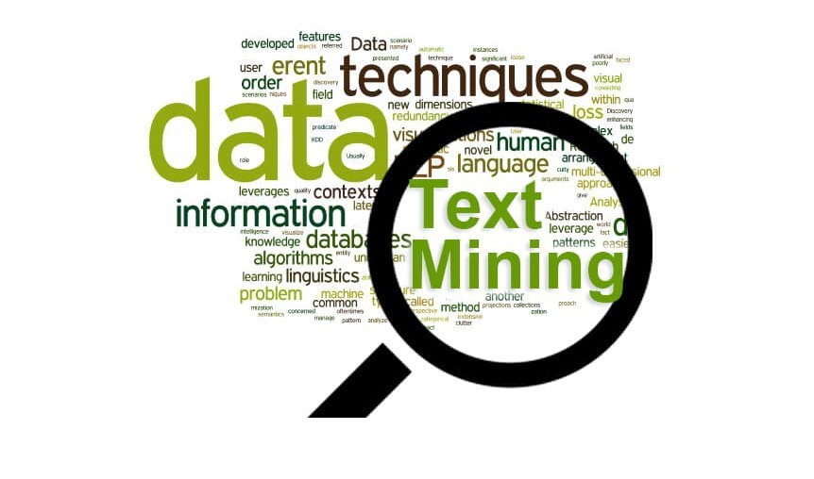
Text Mining and Analysis of Product Reviews
This Python script aims to perform text mining and analysis on product reviews obtained from Flipkart. The specific product being analysed is the "True Human Emperor Anti-Theft Backpack" with USB Charging Port and Back Pocket Legend.

Slide 2

The script scrapes reviews of the specified product from Flipkart.
It iterates over multiple pages of reviews, with a limit of 50 pages. The Beautiful Soup library is used for parsing HTML content.
The requests library is utilized for making HTTP requests to the Flipkart website
Data Scraping:
The script scrapes reviews of the specified product from Flipkart. It iterates over multiple pages of reviews, with a limit of 50 pages. The
Beautiful Soup library is used for parsing HTML content.
The requests library is utilized for making HTTP requests to the Flipkart website

Slide 3
Data Sources and Preprocessing
Data Acquisition
1
Gather text data from diverse sources like websites, databases, and social media platforms.
2
Text Cleaning
Stop words are removed from the text using a predefined list of English stop words.
Feature Extraction
3
Convert unstructured text into numerical representations that can be used by machine learning models.

Slide 4
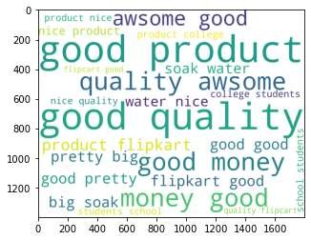
Text Representation Techniques
Bag-of-Words
Word Embeddings
Represent text as a collection of unique words and their frequencies, ignoring word order.
Encode words as dense vectors that capture semantic and syntactic relationships.
Topic Modeling
Discover underlying themes and concepts within a corpus of text documents.

Slide 5

Text Preprocessing
1
Reviews are cleaned and pre-processed to remove unwanted symbols, numbers, and spaces.
2
Tokenization and lowercasing are performed on the text data.
3
Stop words are removed from the text using a predefined list of English stop words.
4
Group customers based on their preferences and behaviors expressed in textual data.

Slide 6



Text Classification
Feature Engineering
Model Training
Performance Evaluation
Prepare the textual data by extracting relevant features for the classification task.
Select and train appropriate machine learning algorithms to learn patterns in the data.
Assess the accuracy and effectiveness of the text classification model.

Slide 7



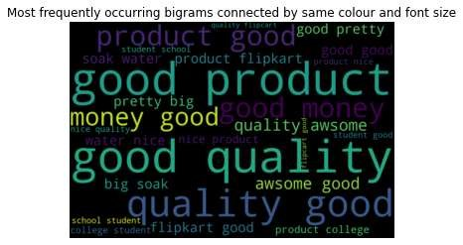
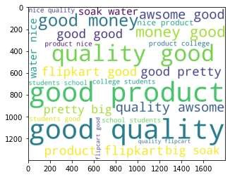
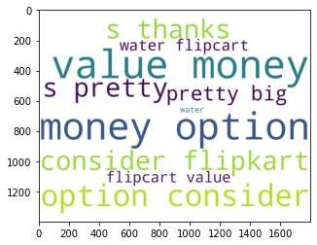
Sentiment Analysis
Negative
Neutral
Positive
Identify and quantify positive opinions and emotions expressed in text.
Detect and measure negative sentiments, critiques, and complaints in textual data.
Distinguish objective, fact-based languagae from subjective, opinion-driven text.

Slide 8

Applications of Text Mining
Customer Insights
Market Intelligence
Analyze customer reviews, feedback, and support interactions to improve products and services.
Monitor online discussions, news, and social media to stay informed about industry trends and competitors.
Risk Management
Knowledge Discovery
Detect potential risks, compliance issues, and security threats by scanning large volumes of textual data.
Uncover hidden connections, patterns, and insights within enterprise data to drive innovation and decision-making.

Slide 9

Conclusion and Future Trends
Overall, this analysis underscores the utility of text mining in uncovering valuable insights from consumer feedback. By leveraging text mining techniques, businesses and consumers alike can gain a more nuanced understanding of product perceptions, enabling informed decision-making.

